Slide 1
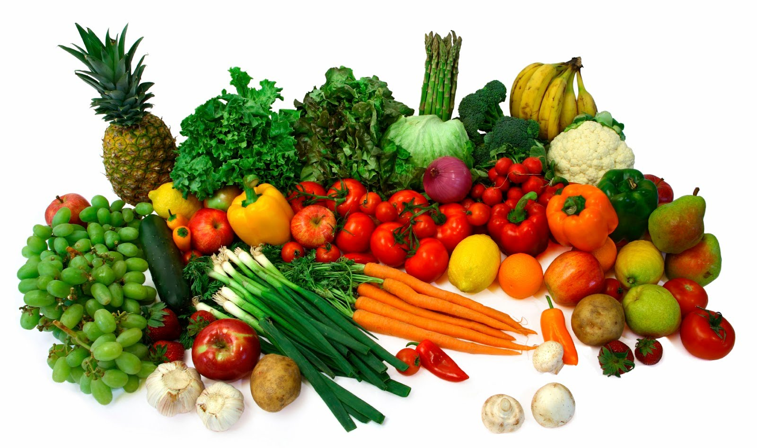
SELLING AGRICULTURAL PRODUCTS
Company: HT ACTIVE
Student: Nguyen Van Tan
Supervisor: Minh Tran – Manh Nguyen
Mentor: Vo Cong Dinh

Slide 2

CONTENT
Company presentation
Working environment
Demonstration
Technical presentation and achievements
Project presentation
Conclusion

Slide 3

COMPANY PRESENTATION
HT Active
Information
CEO: Ho Duc Thuan
Service
Year founded: 2016
Employees: over 16 members
Web applications
Mobile applications
Contact
Mobile games
Email: services@htactive.com
Venue: 63 Phan Dang Luu Street, Hai Chau District, Da Nang City

Slide 4
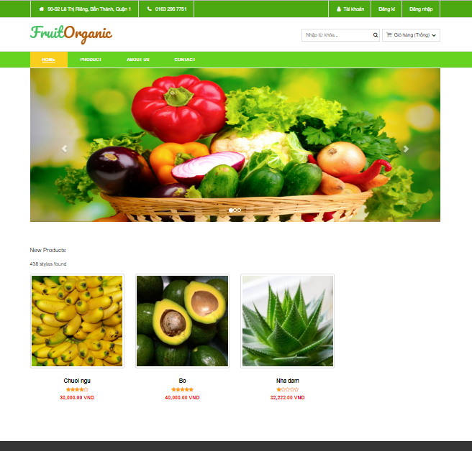
PROJECT PRESENTATION
Idea: To help consumers buy safe food quickly and save time
Tools: Visual Studio Code, GitHub, Trello, Postman
Functions: Login/Register, Search, Cart, CRUD,

Slide 5

TECHNICAL
Application
React JS + Redux
A JavaScript Library
Building user interfaces
Mock API
Free tool
Mock up API
Generate custom data

Slide 6

ACHIEVEMENTS
Building success a
website by
ReactJs
Understanding
about
ReactJs’s structure
Improving
myself

Slide 7
DEMONSTRATION

Slide 8

WORKING ENVIRONMENT
Professional
Friendly
Youthful

Slide 9
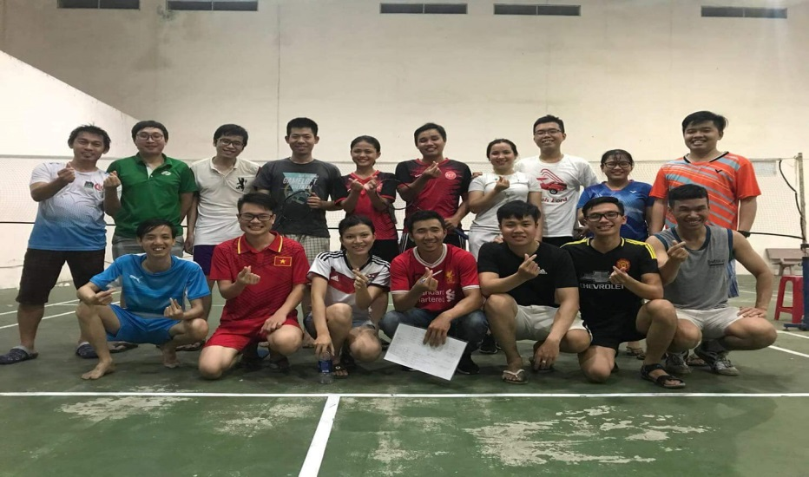
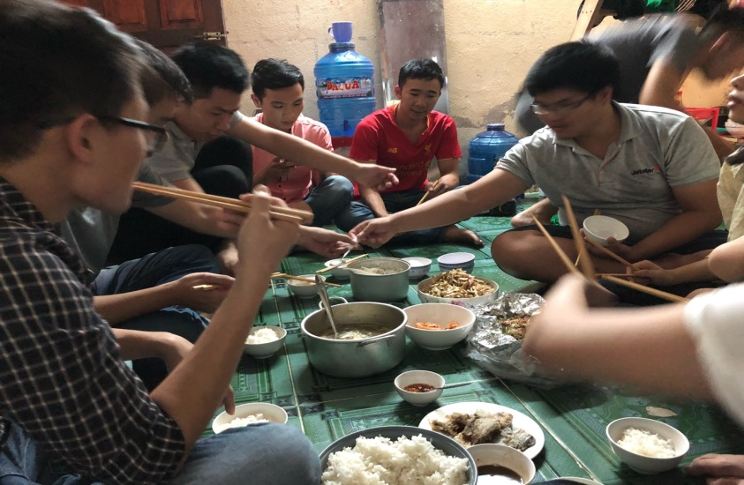
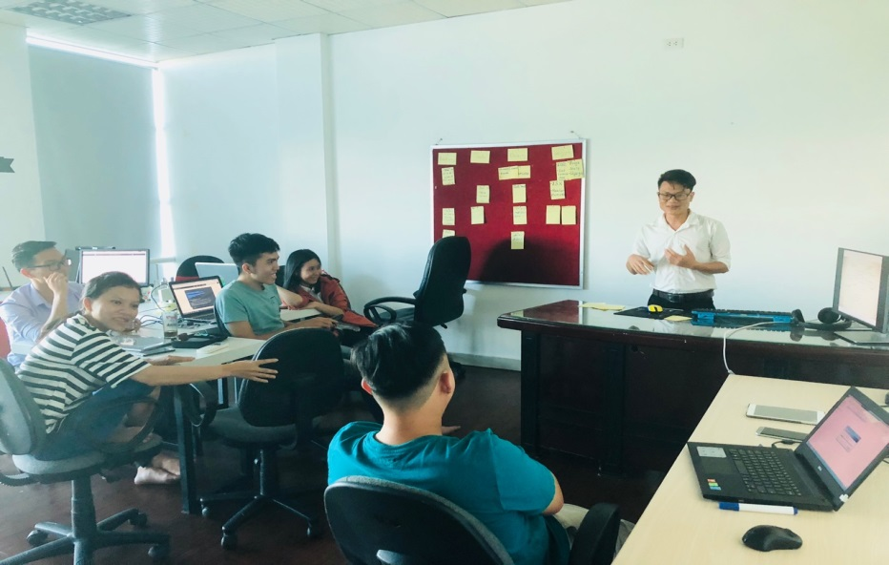
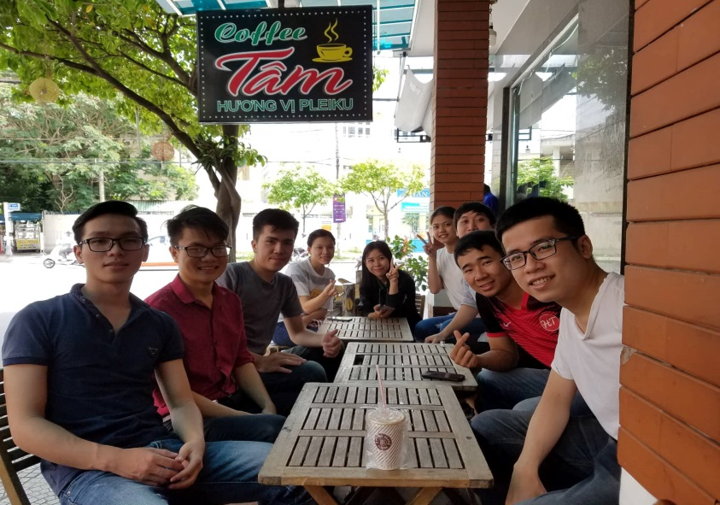
SOME ACTIVITIES

Slide 10

CAREER PATH

Slide 11


QUESTION AND ANSWER

Slide 12


